Slide 1
React code:
Demonstrating an example of React code through the structure of the Actors page:

Slide 2
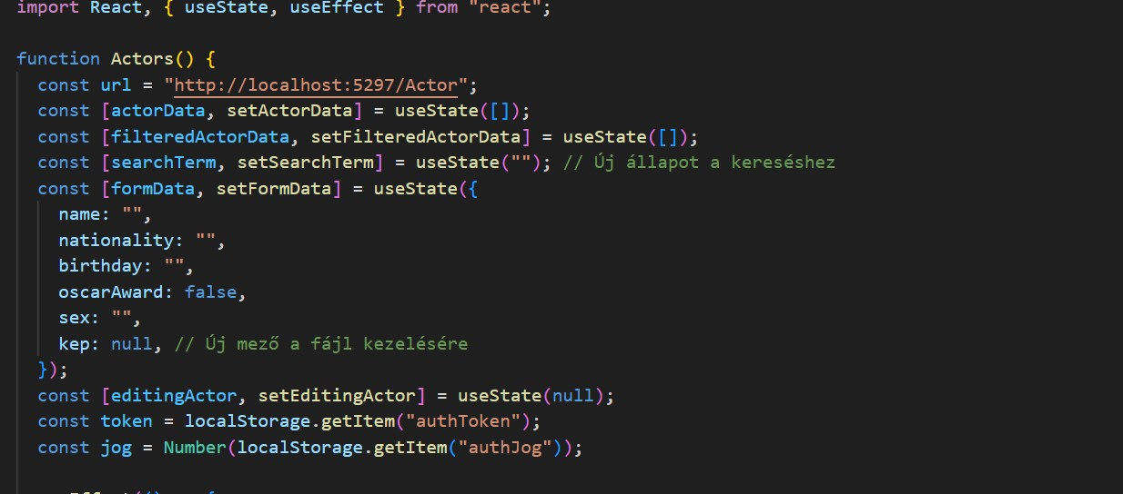
Importing the React component and declaring variables, including the useState variables used by the React useEffect API communications and components stored in localStorage. In localStorage, we store the user’s ID and role.

Slide 3
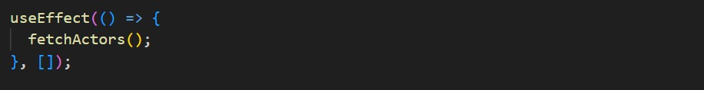
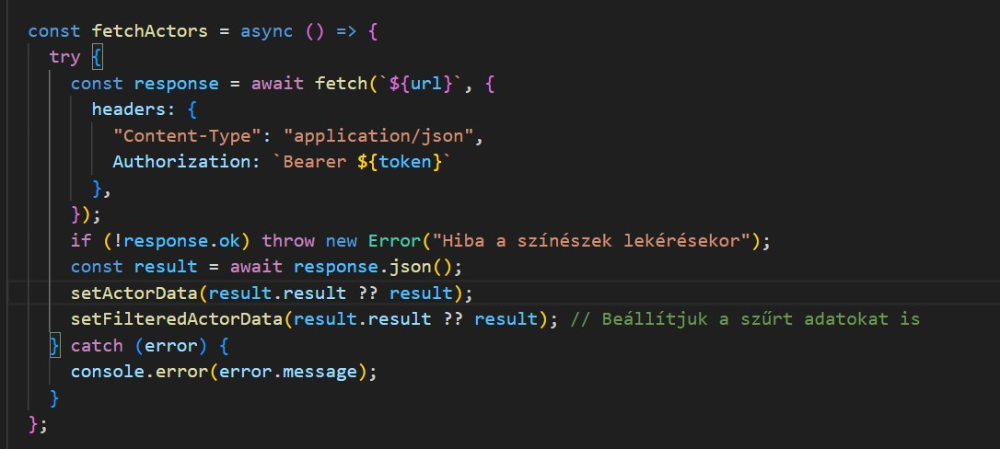
The useEffect hook fetches data from the server, requesting actor data stored in the database asynchronously. It also sends the token needed for authentication to the server and handles any errors in the request:

Slide 4
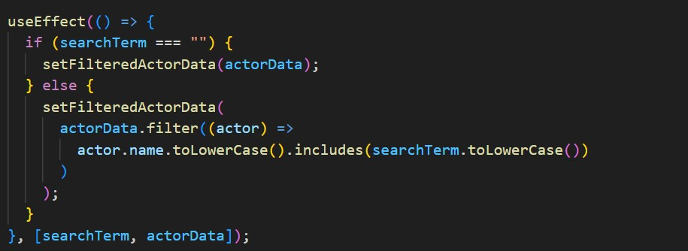
A similar useEffect-based function supports the search bar and provides it with data. It checks if there is a value in the search bar and then filters the actor list based on that value; if not, it returns the original list:

Slide 5
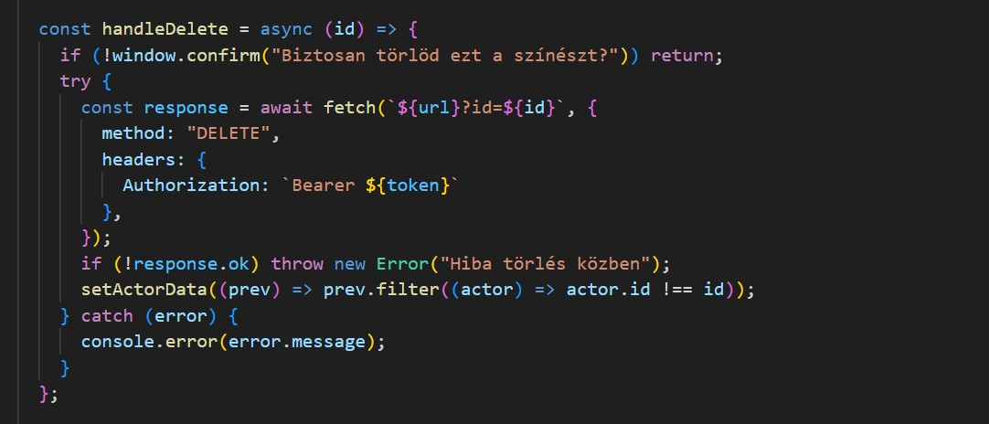
The delete function first asks for confirmation, then sends the selected item’s ID to the delete API endpoint. The backend identifies the selected ID using the appropriate URL and the token. It sends a DELETE method, removes the deleted item from the displayed list, and handles possible server request errors.

Slide 6
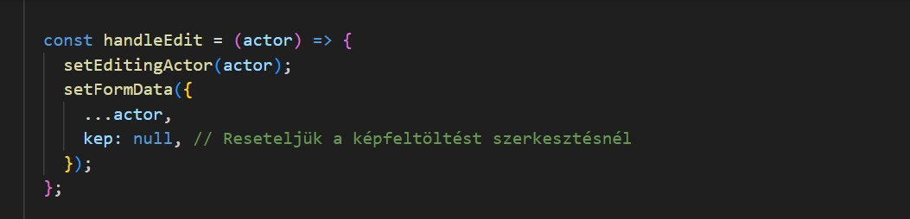
The edit button functions in two parts: the first part opens the edit form and pre-fills it with the actor’s existing data, except for the existing image.

Slide 7
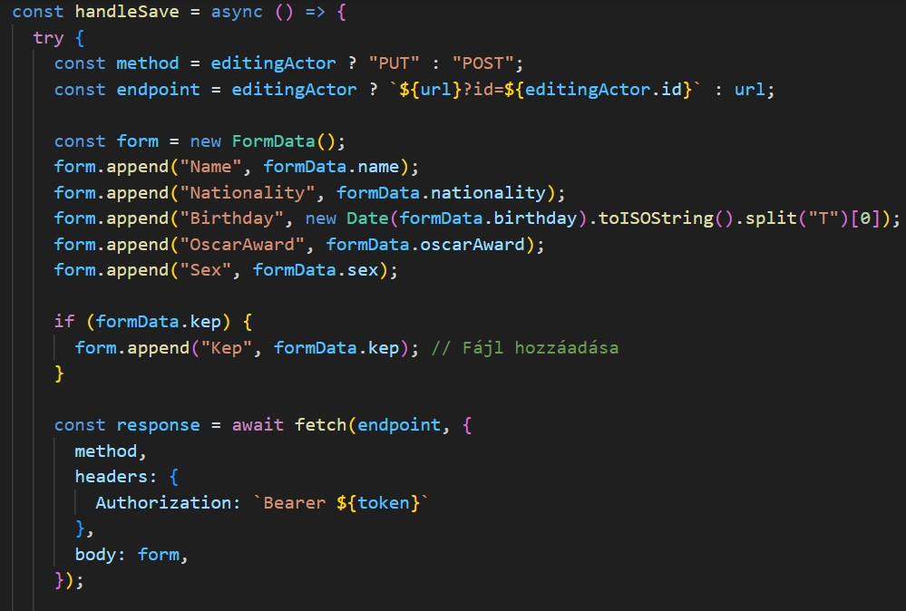
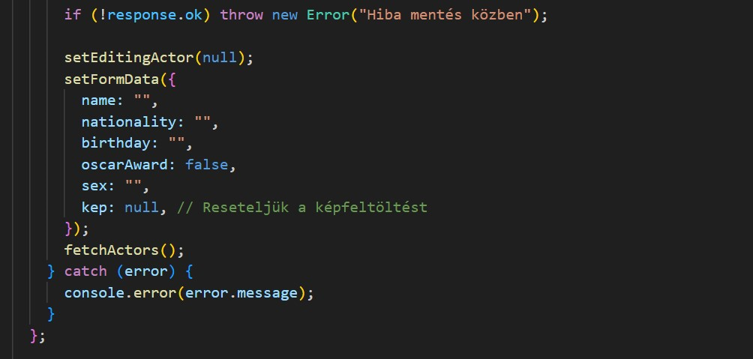
The second part handles the “Save” functionality using a try-catch method. It gathers the data from the form, and through a fetch request using the PUT API endpoint, sends it to the server for modification. The same function also handles adding new actors depending on the value of editingActor. If editing is true (set in the handleEdit function), it uses the PUT method; if false, it uses POST. Finally, it calls the function to fetch actors again to refresh the rendered list or handle any potential errors.

Slide 8
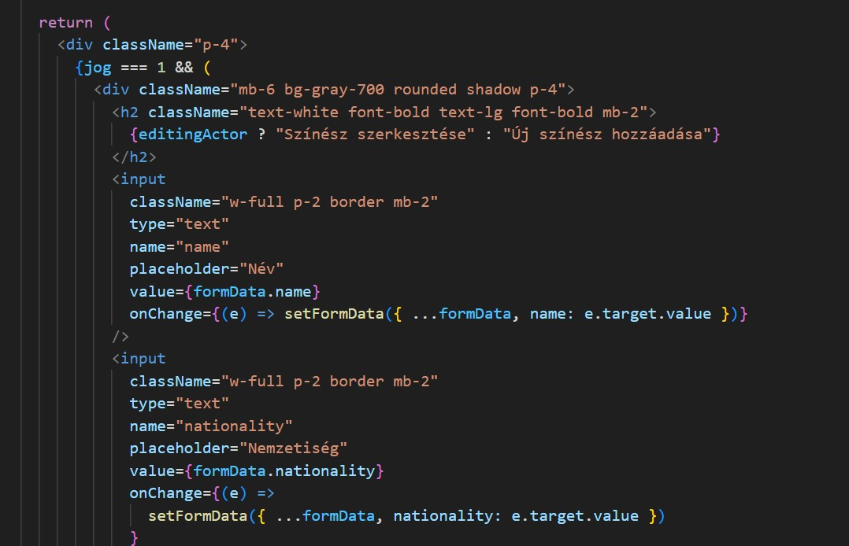
The return value of the Actor page (function) is the rendered HTML-DOM code, starting with the form’s layout. The form is only visible in Admin view:

Slide 9
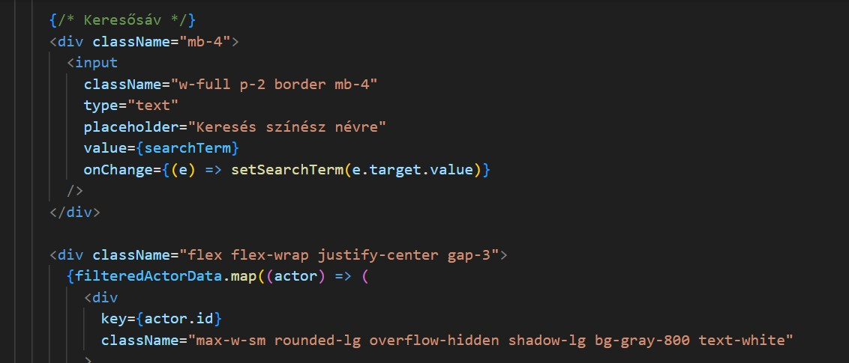
With the search bar:

Slide 10
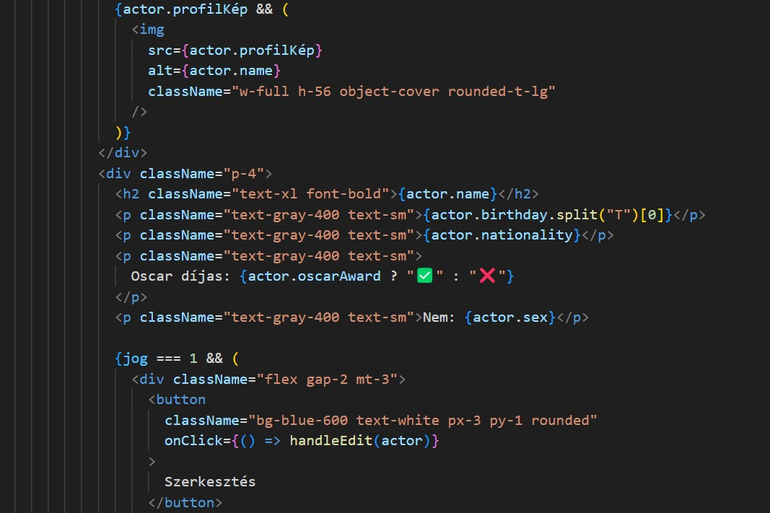
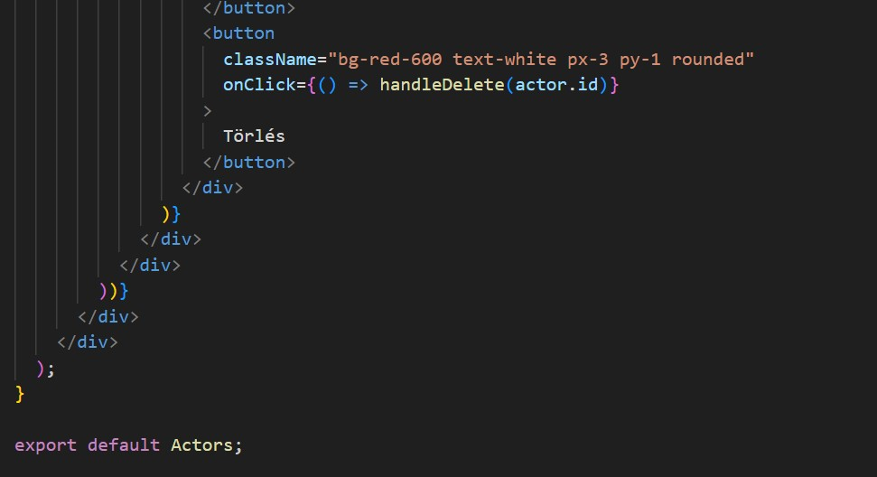
With the cards displaying actor data; the edit and delete buttons are only available to users with admin rights.

